Slide 1
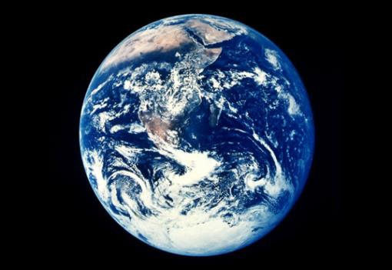
climate CHANGE NEGOTIATIONS AND their impact
Bahareh Seyedi
Climate Change and Energy Advisor
United Nations

Slide 2
Today’s topics
The science behind climate change policy
A brief history of climate change negotiations
2018 COP24 & Sticky issues
The road towards 2020
The role of the United Nations

Slide 3
Climate Change Science:
Why we need to act?
Notes:
The international climate regime is built upon a clear understanding of the threats posed by, and the causes of climate change

Slide 4
The Greenhouse gas effect
Notes:
There are different types of gas in the atmosphere. We need oxygen for example or we wouldn’t be able to breath. Carbon dioxide is another gas that is in the atmosphere, which is actually very important for plans and photosynthesis. So these gases in the right amount is good for us and we need them. But if we play around with the amount and have too much of them in the atmosphere then it causes warming. Most of the solar radiation that reaches the Earth is absorbed by the atmosphere which in turn radiates energy back to space in form of Infrared radiation or heat. But some of it is trapped in the atmosphere and warms the earth. They reason why they get trapped is because the astomphere has greenhouse gases. There are five types of GHGs. are water vapor, carbon dioxide, methane, nitrous oxideand ozone. The most important is carbon dixode.

Slide 5
Concentration of ghgs

Slide 6
All Sectors and Regions have Potential to Contribute

Slide 7
Largest producers of CO2 emissions worldwide in 2016, based on their share of global CO2 emissions

Slide 8
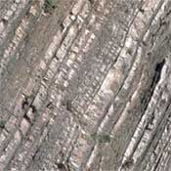
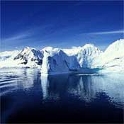
Earth System Science
Parts of the Earth System
Air
Water
Life
Land
Ice
• The atmosphere (air) extends from the Earth surface for several hundred km.
• The hydrosphere (water) includes the ocean, rivers, lakes, groundwater, vapor.
• The biosphere (life) includes bacteria, protists, plants, and animals.
• The geosphere (land) includes minerals, rocks, molten rock, sediments, soils.
• The cryosphere (ice) includes snow, glaciers, and sea ice.
Notes:
What’s important to understand is that the atmosphere is only one part of the Earth system. There are parts. For example, water.

Slide 9
The Earth System: It’s all connected!
Air
Ice
Water
Land
Life

Slide 10
Climate change evidence and observed impacts

Slide 11
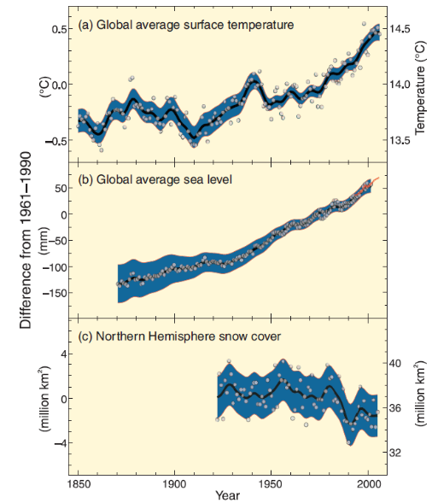
Observed Changes:
GLOBAL AVERAGE SURFACE TEMPERATURE
GLOBAL AVERAGE SEA LEVEL
NORTHERN HEMISPHERE SNOW COVER
SOURCE: IPCC
Notes:
Eleven of the last twelve years (1995-2006) rank among the twelve warmest years in the instrumental record of global surface temperature (since 1850). The linear warming trend over the 50 years from 1956 to 2005 is nearly twice that for the 100 years from 1906 to 2005.
The temperature increase is widespread over the globe and is greater at higher northern latitudes. Average Arctic temperatures have increased at almost twice the global average rate in the past 100 years.
Increases in sea level are consistent with warming. Global average sea level rose at an average rate of 1.8 mm/year over 1961 to 2003 and at an average rate of about 3.1 mm/year from 1993 to 2003.
Observed decreases in snow and ice extent are also consistent with warming. Satellite data since 1978 show that annual average Arctic sea ice extent has shrunk by 2.7% per decade, with larger decreases in summer. Mountain glaciers and snow cover on average have declined in both hemispheres.
Source: IPCC, 2007

Slide 12
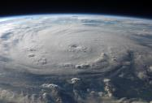
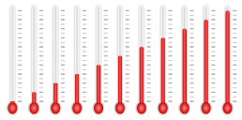
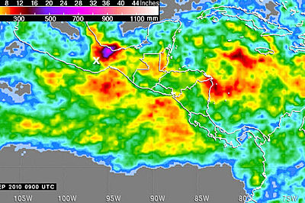
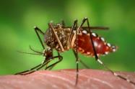
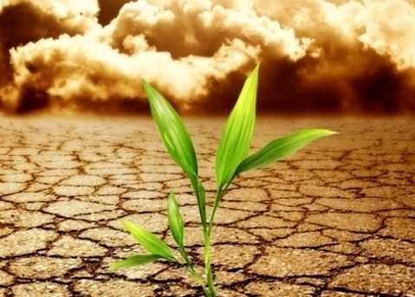
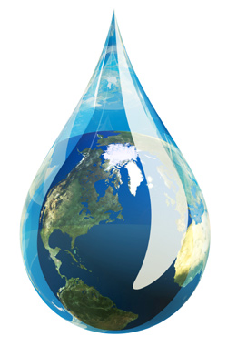
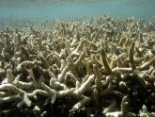
OBSERVED impacts
Increase Temp and # of warm days
Extreme weather events
Sea level rise
Variation of rainfall patterns
Distribution of carriers of disease
Food insecurity
Water supply
Coral bleaching / Habitats

Slide 13
Examples of impacts
Droughts have become more common, especially in the tropics and sub-tropics since the 1970s.
An observed increase in precipitation intensity is increasing the frequency of extreme weather and floods.
Increased annual rainfall especially at higher latitudes (Finland) and countries such as China and Myanmar
Decreased annual rainfall in West Africa, Southern Europe and Southern Latin America

Slide 14
Why does it matter?

Slide 15
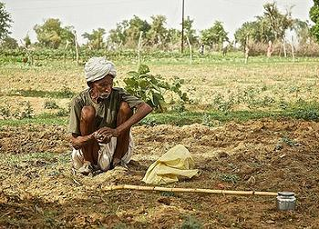
Notes:
Decreased annual rainfall in West Africa, Southern Europe and Southern Latin America

Slide 16
Notes:
It matters to people who live in places that won’t exist anymore – tropical islands – Maldives capital, Male, shown.
As water gets warmer, it takes up more space. Each drop of water only expands by a little bit, but when you multiply this expansion over the entire depth of the ocean, it all adds up and causes sea level to rise. Rising sea level is a threat to people who live near the ocean. Some low-lying areas will have more frequent flooding, and very low-lying land could be submerged completely. Rising sea level can also harm important coastal ecosystems like mangrove forests and coral reefs.
According to NASA, climate change is causing ocean temperatures to rise, which in turn is increasing the intensity of tropical storms and hurricanes.

Slide 17
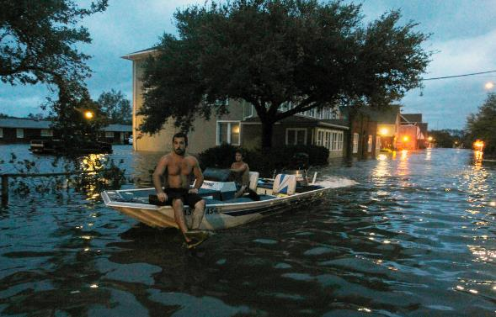
Notes:
An observed increase in precipitation intensity is increasing the frequency of extreme weather and floods.

Slide 18
Notes:
Sandy, as the hurricane became known, caused around $71bn in damages and killed 117 people along the eastern seaboard. One third of those casualties were from New York City alone. The effect of the hurricane was disproportionately felt - the city's most vulnerable residents, people of low income and the elderly, were hardest hit.
Rising ocean levels and increased precipitation are exacerbating the effect of flooding on coastal cities such as New York City.

Slide 19
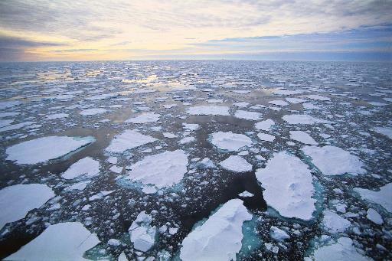
Notes:
Sea level is also rising because melting glaciers and ice sheets are adding more water to the oceans.

Slide 20
climate change negotiations

Slide 21
brief HISTORY
IPCC established 1988 – provides a clear scientific view on the current state of CC
1990 – IPCC 1st Assessment Report
… 2018 IPCC Special Report, “Global warming is likely to reach 1.5°C between 2030 and 2052 if it continues to increase at the current rate”
1992 – UNFCCC text adopted – to stabilize GHG concentrations in the atmosphere to prevent dangerous anthropogenic interference → non-binding GHG limits, no enforcement mech
1995 – first COP
1997 - Kyoto Protocol adopted (2005), legally binding commitment to reduce GHG emissions ≥ 5% vs 1990, ‘common but differentiated responsibilities’
2008-2012 - 1st KP commitment period
2015 Paris Agreement – 195 signatories, limit warming well below 2⁰ > pre-industrial levels & try to limit to 1.5⁰, set own targets
Notes:
Intergovernmental Panel on Climate Change (IPCC) = Doesn’t do original research, it assesses literature. 1000s of experts volunteer to contribute. Line by line review by governments. Produces Assessment Reports.
UN Framework Convention on Climate Change (UNFCCC), the main international treaty on climate change. Adopted 1992, into force 1994. Set non binding limits on greenhouse gas emissions for individual countries and contains no enforcement mechanisms.

Slide 22
Why reaching an agreement has taken so long?

Slide 24
Global north vs global south

Slide 25
GLOBAL NORTH
GLOBAL SOUTH
Austria, Japan, Canada, New Zealand, Norway, US, Russia, Ukraine
European Union
Developing and Least Developed Countries
Small Island Developing States
Notes:
In the negotiations, countries usually do not act alone, they act in blocs.

Slide 26
Key Issues on the Negotiations over the Years
Voluntary or mandatory targets
Bottom up or top down
Who pays
Who reduces – 1 track or 2
Types of targets: sectoral, vs BAU, per capita, absolute / relative to baseline
Role of sinks (LULUCF, REDD+)
Funding for adaptation – impacts ongoing
How do you MRV / accountability?
Country buy-in to Kyoto & Paris
Financial & technology incentives to take action

Slide 28
Countries’ Response to the Paris Agreement
Early entry into force on 4 November 2016
181 out of 197 Parties have ratified the Paris Agreement
177 Parties have already submitted their first NDC
Unprecedented momentum for climate action in virtually all countries

Slide 29
fROM PARIS TO KATOWICE THE ROAD TO 2020
2015+ COP21 submit 1st NDC, revise in 2020
2016 COP22 Marrakesh
2017 COP23 Bonn
2018 – COP24 Katowice / Global Stocktake
2019 - UN Secretary General’s Climate Summit / COP25 Brazil
2020 - “Start” of the Paris Agreement, invitation to submit LT-LEDS (long-term low GHG emission development strategies)

Slide 30
Why does cop24 maTTER?
COP24 must unleash the full potential of the Paris Agreement by finalizing the Paris Agreement Work Programme. This will put into place the practical implementation guidelines needed to track progress and ensure that climate action is transparent. This in turn will build trust and send a signal that governments are serious about addressing climate change.
COP24 also needs to establish a clear way forward on climate finance to ensure greater support for climate action in developing countries.
COP24 is an opportunity to take stock of where we are (Talanoa Dialogue) and send a strong political signal to raise ambition and take into account the IPCC 1.5 report

Slide 31
Paris Agreement Work Programme
In Paris not all has been agreed
Decision 1/CP.21 mandates to further develop the details
SBs-48 / APA 1.5 (May 2018)
Additional session in (Aug-Sep. 2018, BKK)
2018 @ COP 24
Next iteration of texts towards final decision
Final negotiations on the texts / adoption of the PAWP package
Further advancement on substance and options
Notes:
Subsidiary Body for Scientific and Technological Advice

Slide 32
kEY ISSUES ON THE GUIDELINES
Key issues still to be resolved by COP24 include the respective contributions and responsibilities of developed and developing countries, given their national circumstances and differing levels of development, with regards to:
transparently and regularly communicating their actions; and
providing full clarity about the provision of support, especially climate finance, now and over the long-term
Recognizing that every country has its own unique circumstances, COP24 needs to ensure that the Paris Agreement works fairly for all while ensuring that the greatest and most ambitious possible climate action is take

Slide 33
IPCC 1.5 report
The International Panel on Climate Change (IPCC) consists of hundreds of scientists from around the world
IPCC gathers evidence and reports on impacts of climate change
The 1.5 Special Report investigates whether its possible to keep global warming to no more than 1.5 degrees
Answering key questions:
Is global warming happening now?
Is there a difference between reaching 1.5 and 2 degrees
Can we get to 1.5?
What do we need to do?

Slide 37
iMPACTS OF THE 1.5 report on negotiations
Confirms the need to strongly commit to the Paris Agreement’s aims of limiting global warming to well below 2ºC and pursuing efforts towards 1.5°C.
The world has already warmed by 1°C due to human activity. As a result, climate change is already affecting people, ecosystems and livelihoods across the globe. All countries are affected by global warming, but the impacts tend to fall disproportionately on the poor and vulnerable.
The IPCC projects that a 2°C rise in the global average temperature would lead to worse global and regional climate impacts than a 1.5°C rise.
Limiting warming to 1.5°C is still possible, but it will require that we make unprecedented transitions in all aspects of society to achieve zero net emissions by mid-century, including by:
moving the world economy onto a low-emissions pathway;
transforming our energy, agricultural, urban and industrial systems over the next 10 to 20 years; and
pursuing new technologies, cleaner energy sources, less deforestation, better land management and sustainable agriculture.
Doing less now would shift the burden of responsibility to future generations.

Slide 38
wHY CLIMATE FINANCE MATTERS?
The climate does not care where emissions originate. Many developing countries need support in order to contribute to global action and to the goals of the Paris Agreement.
The Convention and the Paris Agreement clearly establish the obligation for developed countries to provide support for developing countries: technology, finance and capacity building.
Many developed countries have reconfirmed their pledge to mobilize USD 100 billion p.a. to support climate action in developing countries. Clear progress towards the USD 100 billion goal will send a much-needed positive political signal.
COP24 will consider the third Biennial Assessment report containing a global overview of private and public climate finance flows. It will assess the implications of these flows, their composition, purpose and emergent trends relevant to the UNFCCC and Paris Agreement goals.

Slide 39
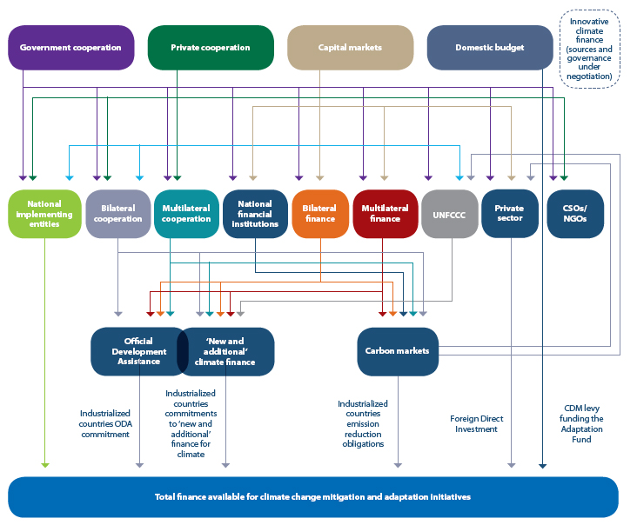
Climate Finance Landscape
Source: Adapted by Yannick Glemarec from Atteridge and others (2009)
Notes:
complicated landscape climate finance sources (including public, private, national and international)
> 50 international public funds, 60 carbon markets and 6,000 private equity funds already providing “green” finance
Multiple types of finance (such as carbon finance, finance for REDD+, etc.)
A variety of tools for delivering and packaging financing (such as sectoral approaches, performance-based payments, etc.)
access to national budgets
Bilateral finance (e.g., Japan and Caribbean, Germany / Norway / France)

Slide 40
Sources of Climate Finance
Global Environment Facility (1992) operates UNFCCC financial mechanism, channels funds to developing countries through grants (US$ 17B) or loans
Adaptation Fund (2007) under Kyoto Protocol of UNFCCC – 2% share of CER sales, World Bank = trustee, US$ 285M project support
Copenhagen Accord (2009) – Announced intention for “fast start” finance (US$ 30B by 2010-2012) and the goal of mobilizing US$ 100B per year by 2020
Green Climate Fund (2010) – 50/50 mitigation and adaptation, unlock private finance, 93 projects … pledged US$ 10.3B, committed $4.6B, projects under implementation $1.6B
NAMA Facility (2012) – 1st call for projects 2013, funding from BMU, UK, Denmark and EC (EUR 260M over 20 projects)

Slide 41
Facilitative dialogue among Parties in 2018 to take stock of the collective efforts of Parties in relation to progress towards the long-term goal of the Paris Agreement
The conclusion of this year’s Talanoa Dialogue will give Ministers the opportunity to take stock of where are we today, to consider the IPCC Global Warming of 1.5°C report, and to provide a political signal for enhanced ambition.
Notes:
Should be constructive, facilitative and solutions oriented and should not lead to discussions of a confrontational nature in which individual Parties or groups of Parties are singled out;
Will be structured around three general topics:
Where are we?
Where do we want to go?
How do we get there?

Slide 42
What is UN’S role?
The United Nations provides an essential platform for international cooperation and for ambitious climate action by national and local governments, businesses and civil society.
Tackling climate change is critical to a sustainable future
Sustainable Development
“development that meets the needs of the present without compromising the ability of future generations to meet their own needs”
Brundtland Report (1987)
Notes:
What needs? Food, water, biodiversity, ecosystems, energy, health, poverty alleviation, resilience
Climate change affects all of these systems & will fundamentally alter how humans interact with them

Slide 43
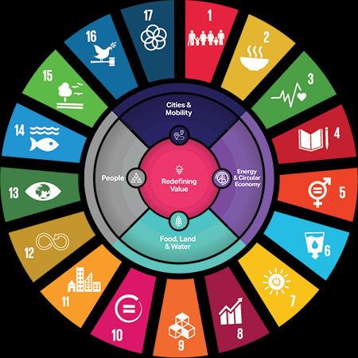
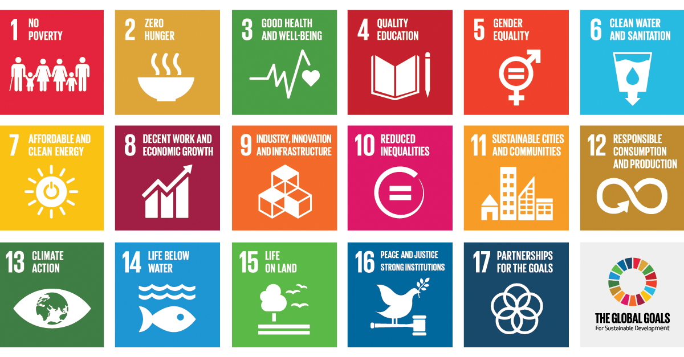
2030 Agenda for Sustainable Development and SDGs
Notes:
Core of the work we do:
Sustainable development and climate change (mitigation and adaptation) are closely linked, and activities through the NDC have strong alignments with the Sustainable Development Goals (SDGs) under the 2030 Agenda for Sustainable Development
SDG 13: Take urgent action to combat climate change and its impacts
Target 13.1: Strengthen resilience and adaptive capacity to climate-related hazards and natural disasters in all countries
Indicator 13.1.1: Number of deaths, missing persons and persons affected by disaster per 100,000 people
2030 Agenda for Sustainable Development, adopted by all United Nations Member States in 2015, provides a shared blueprint for peace and prosperity for people and the planet, now and into the future. At its heart are the 17 Sustainable Development Goals (SDGs) & 244 SDG indicators
Encourages member states to "conduct regular and inclusive reviews of progress at the national and sub-national levels, which are country-led and country-driven → Voluntary national reporting informs high level policy

Slide 44
Local solutions

Slide 45
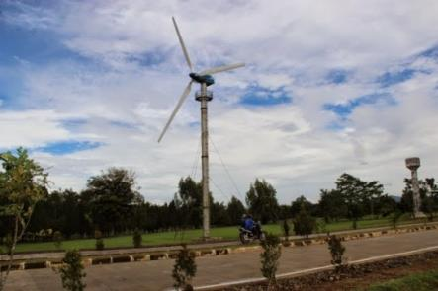
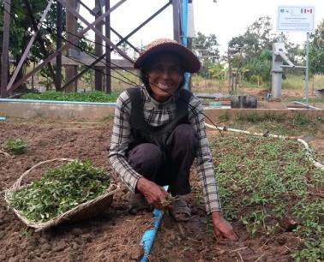
Reducing emissions
Adapting to impacts
Switch to clean energy
Use less energy
More efficient transportation systems
New crop varieties
Sea walls
Flood and cyclone shelters

Slide 46
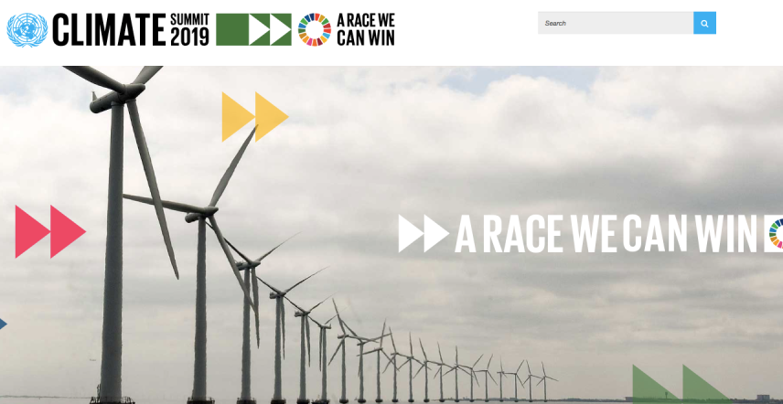
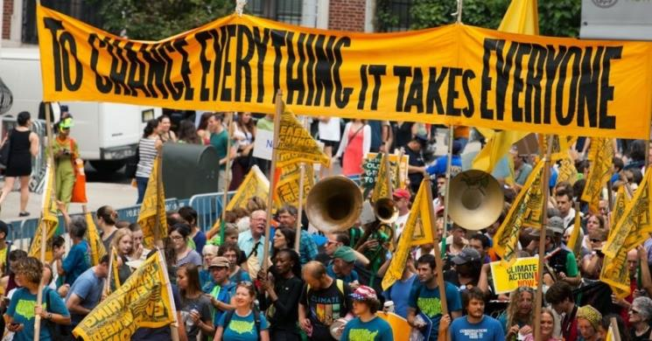

Slide 47
Thank you!
Email: Bahareh.seyedi@un.org
Twitter: @BaharehSeyedi

